Slide 1

Social Science Research Design and Statistics, 2/e
Alfred P. Rovai, Jason D. Baker, and Michael K. Ponton
Between Subjects Analysis of Variance
PowerPoint Prepared by
Alfred P. Rovai
IBM® SPSS® Screen Prints Courtesy of International Business Machines Corporation,
© International Business Machines Corporation.

Slide 2
Uses of the Between Subjects Analysis of Variance
The Between Subjects Analysis of Variance (ANOVA) is a parametric procedure that tests the hypothesis that there is no difference between the population means (μ) of three or more independent groups on a single factor (i.e., one IV).
  The independent t-test is used to compare the means of two independent groups on a single factor.
It also tests the hypotheses that there are no differences between the population means (μ) of two or more independent groups on multiple factors (i.e., a factorial ANOVA) and that there are no interaction effects between factors.

Slide 3
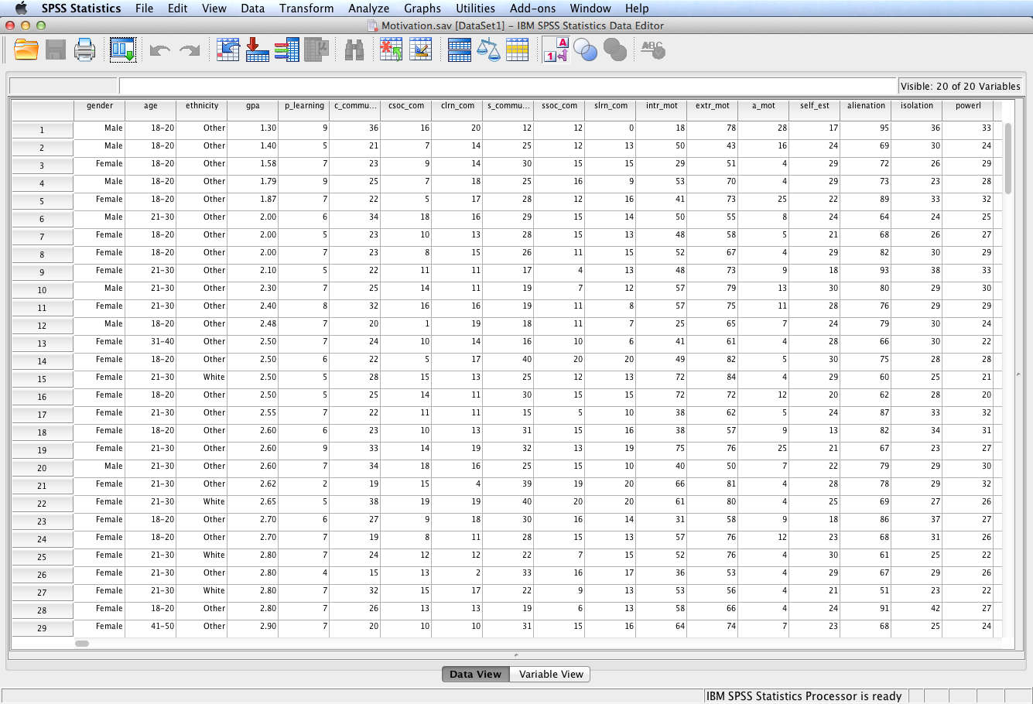
Open the dataset Motivation.sav.
File available at http://www.watertreepress.com/stats

Slide 4
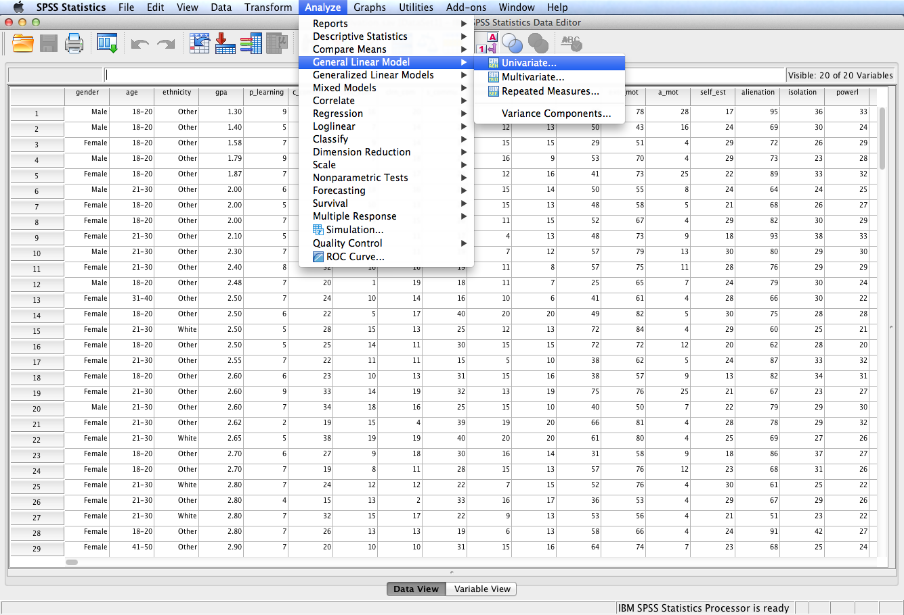
Follow the menu as indicated to select a univariate ANOVA (i.e., an ANOVA with a single DV).

Slide 5
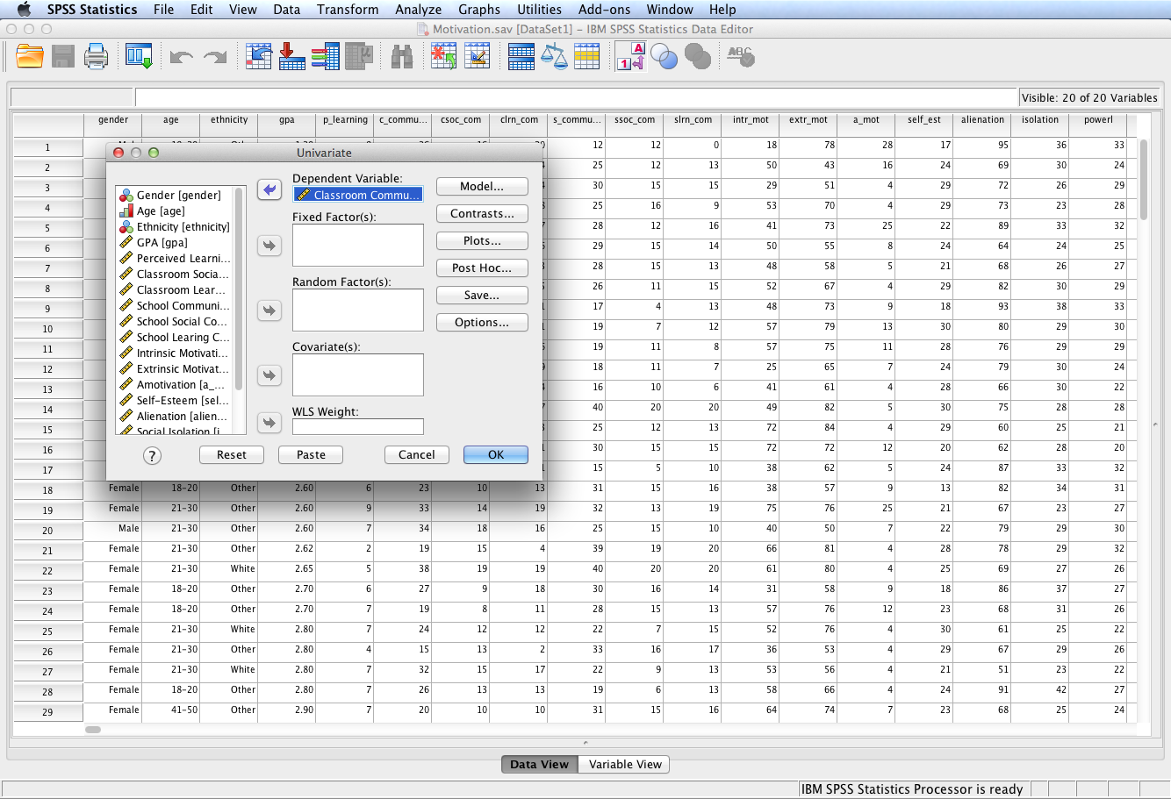
Select and move the Classroom Community
variable to the Dependent Variable: box.
In this example, we will conduct a two-way factorial ANOVA (i.e., two factors) and test the following three null hypotheses:
H₀₁: There is no difference in sense of classroom community between graduate students based on gender (male, female).
H₀₂: There is no difference in sense of classroom community between graduate students based on age (18-20, 21-30, 31-40, 41-50, over 50).
H₀₃: The difference in sense of classroom community between students based on gender remains constant regardless of age.
Since there are two between subjects factors (IVs), this is a two-way between subjects ANOVA.

Slide 6
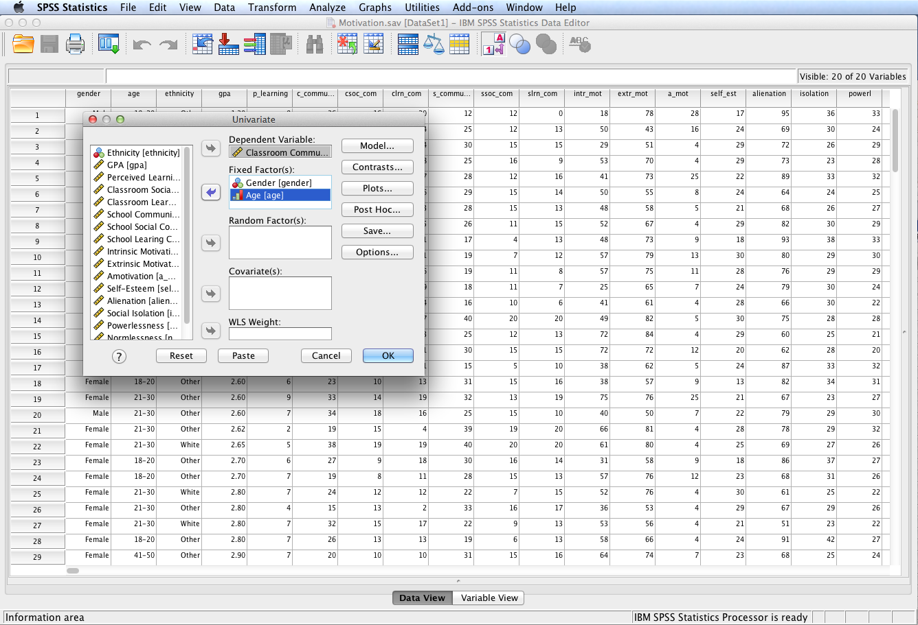
Select and move the Gender and Age variables to the
Fixed Factor(s): box; click Plots to display the Profile Plots dialog.
Note: A fixed factor has only the levels used in the analysis (e.g., gender and age). A random factor has many possible levels and only a subset of levels are used in the analysis.

Slide 7
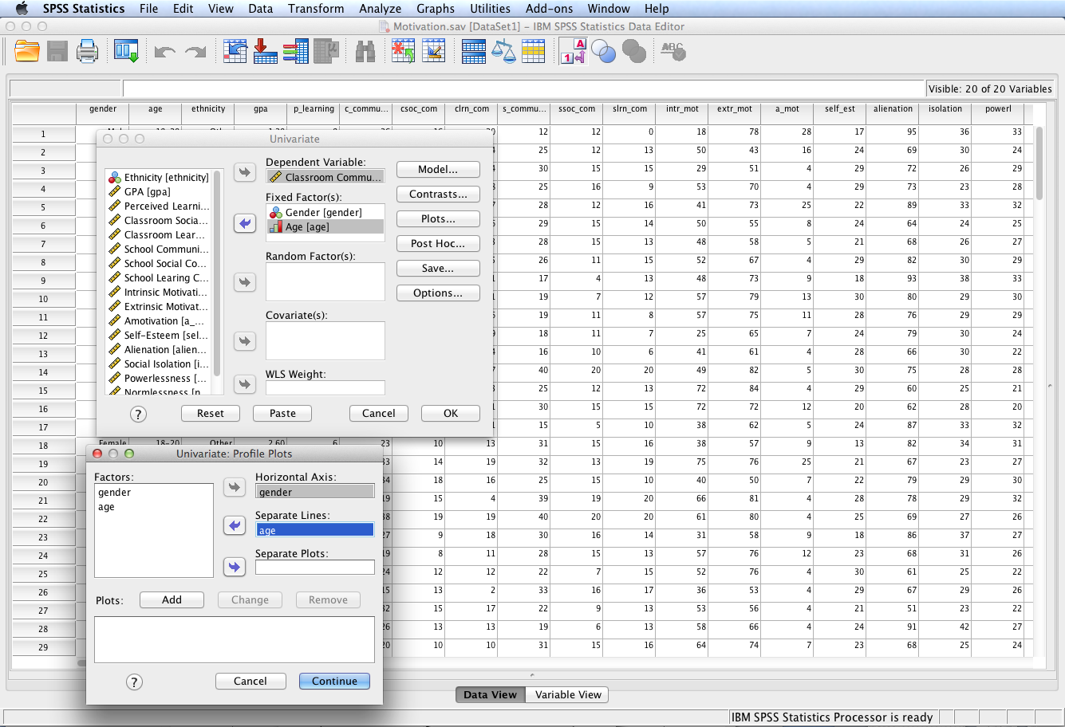
Move gender to the Horizontal Axis: box and age to the Separate Lines: box.
Click Add.

Slide 8
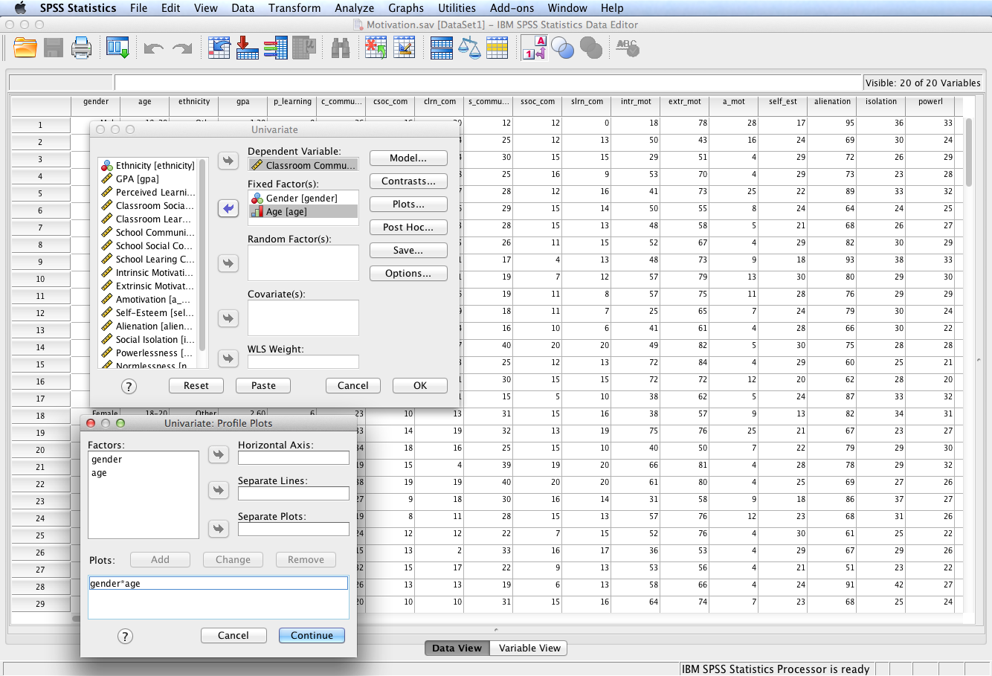
The gender*age profile plot will be included in the SPSS output. Click Continue.

Slide 9
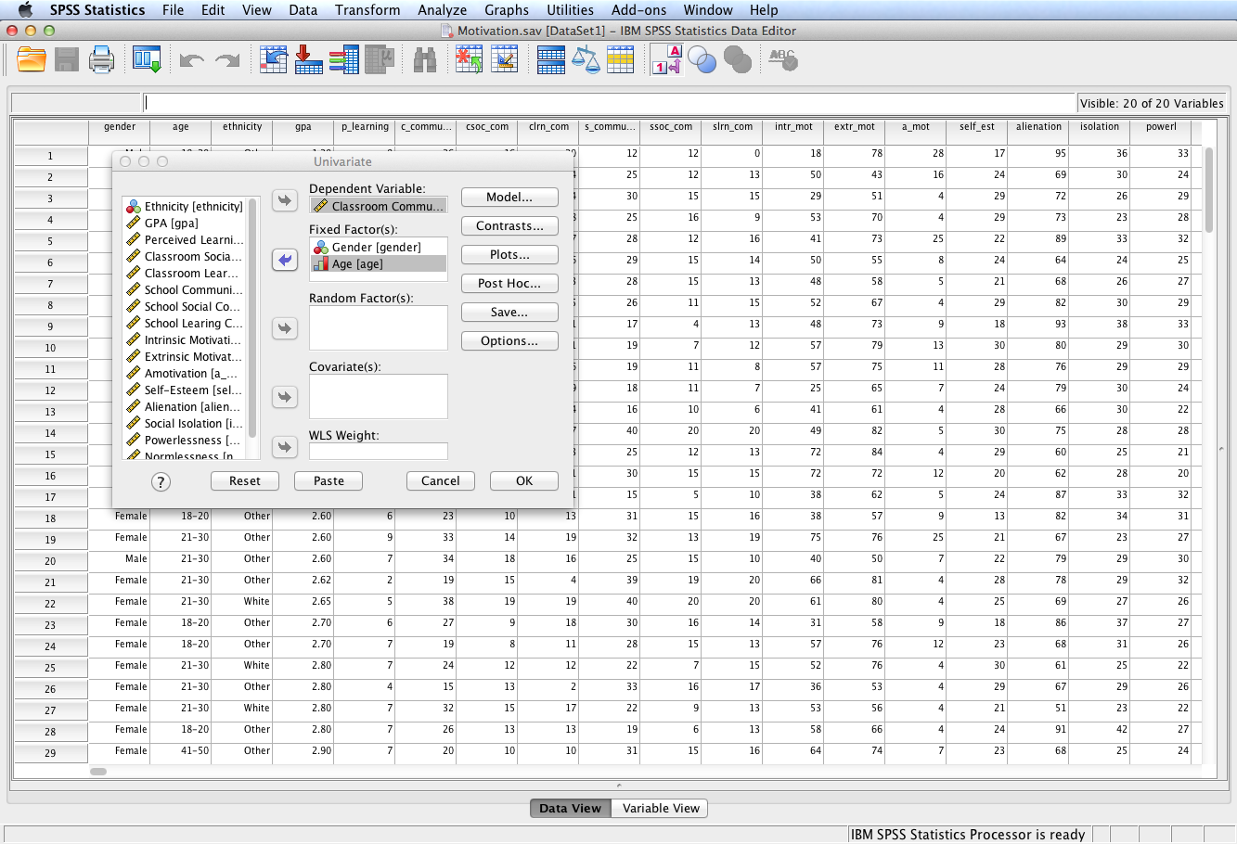
Click Post Hoc… to display the Post Hoc Multiple Comparisons for Observed Means dialog.

Slide 10
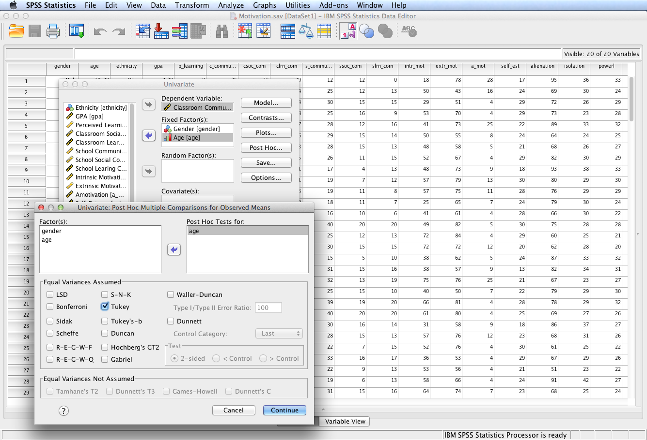
Move age to the Post Hoc Tests for: box. If the age factor is significant, post hoc tests will be required to determine group differences since there are six age categories. If the gender factor is significant, post hoc tests are not required because gender has only two categories.
Assume equal variances is tenable and select an appropriate post hoc test. In this example Tukey is selected because it is neither very conservative (like Scheffe) or very liberal (like LSD). If output shows equal variances is not tenable (i.e., if Levene’s test is significant), the post hoc procedure will need to be conducted again with an appropriate equal variances not assumed post hoc test
Click Continue.

Slide 11
Click Options to display the Options dialog.

Slide 12
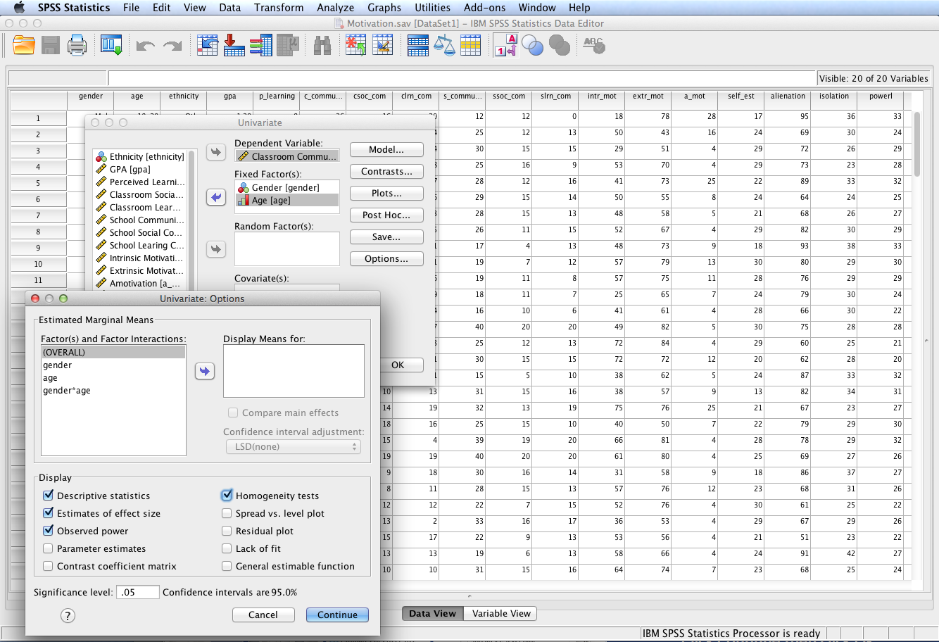
Select Descriptive statistics, Estimates of effect size, Observed power, and Homogeneity tests.
Observed power will display the statistical power of each tested effect. Estimates of effect size will display partial eta squared for each effect and the overall ANOVA. Homogeneity tests will produce Levene’s test of equality of error variances.
Click Continue then click OK to run the ANOVA.

Slide 13
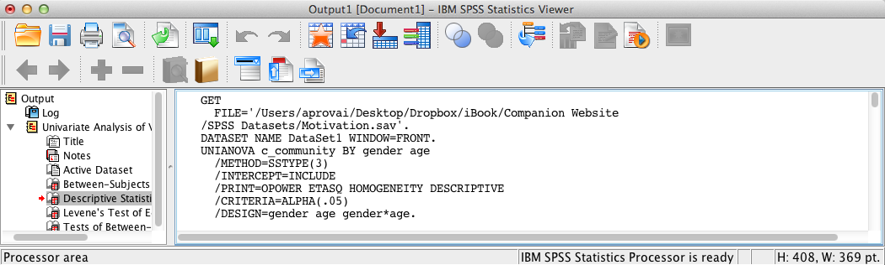
SPSS Output
The contents of the SPSS Log is the first output entry. The Log reflects the syntax used by SPSS to generate the output.

Slide 14
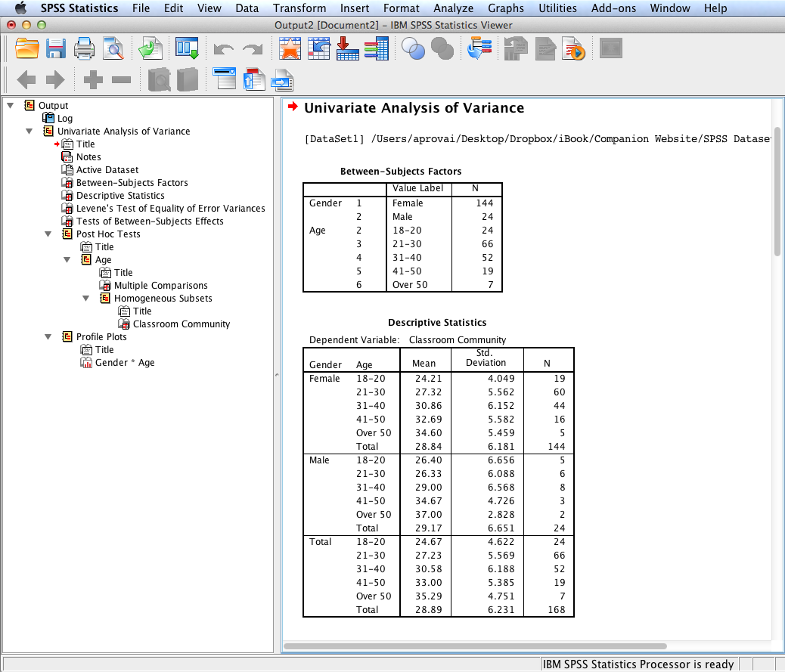
SPSS Output
SPSS output includes a table listing each between subjects factor that displays each category, value label, and sample size.
Also provided is a descriptive statistics table.

Slide 15
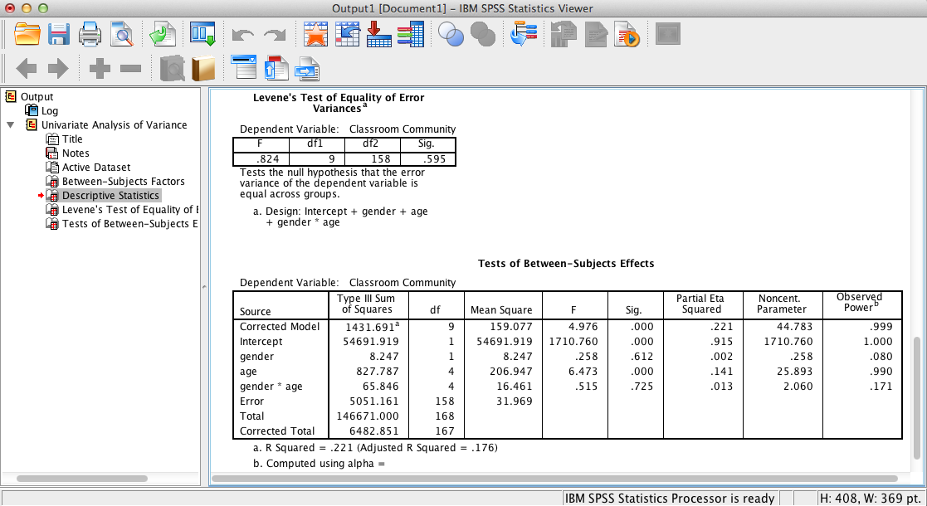
SPSS Output
SPSS output includes the results of Levene’s test, which shows that the assumption of equal variances is tenable since p > .05.
Tests of between subjects effects show that the overall ANOVA and the age main effect are significant, p < .001. However, the gender main effect, p = .61, and the gender * age interaction effect, p = .73, are not significant. Partial eta squared is a measure of effect size for each effect. Note the low power for the gender and interaction effects, suggesting the relatively high probability of a Type II error (power should be >= .80).

Slide 16
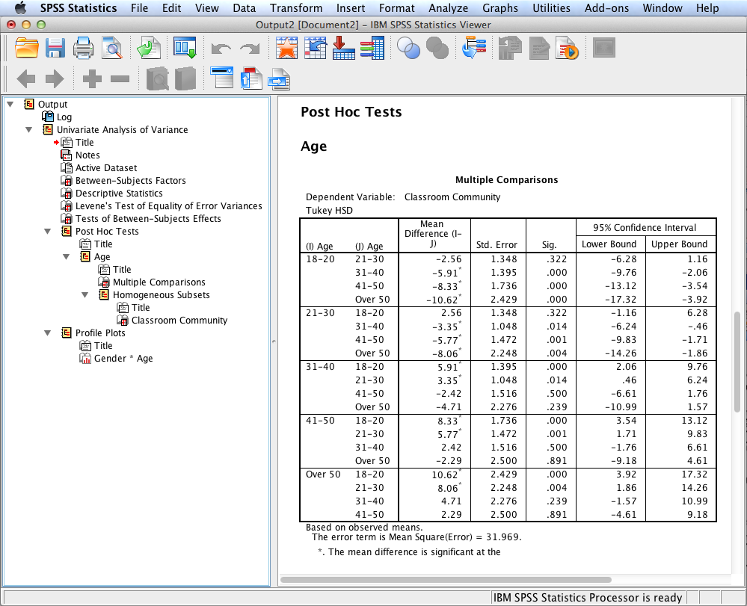
SPSS Output
Tukey Honestly Significant Difference (HSD) post hoc multiple comparison tests are also displayed. These results show that significant differences exist between the following age categories:
18-20 and 31-40
18-20 and 41-50
18-20 and Over 50
21-30 and 31-40
21-30 and 41-50
21-30 and Over 50

Slide 17
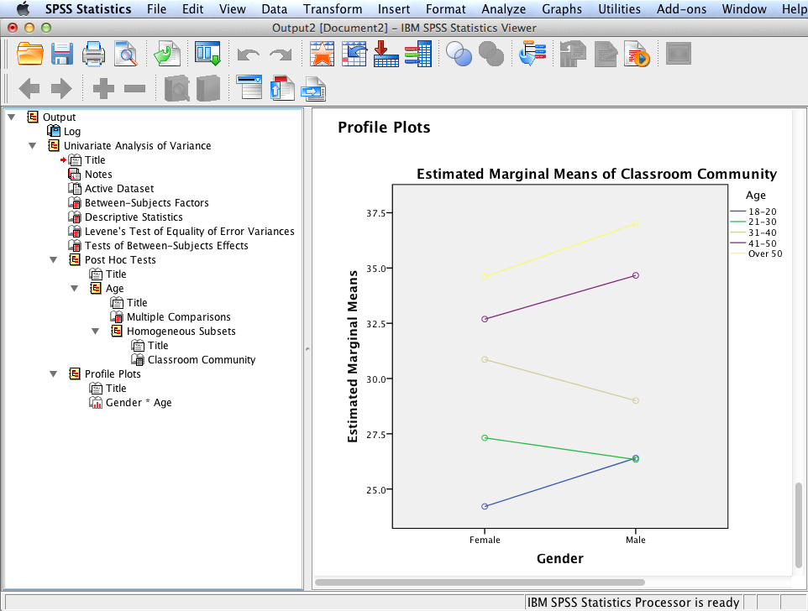
SPSS Output
SPSS output also displays the requested profile plot that graphically displays the non-significant gender * age interaction effect.

Slide 18
ANOVA Results Summary
H₀₁: There is no difference in sense of classroom community between graduate students based on gender (male, female). The gender main effect, F(1,158) = .26, p = .61, η_{p}² = .002, is not significant. Consequently there is insufficient evidence to reject the null hypothesis.
H₀₂: There is no difference in sense of classroom community between graduate students based on age (18-20, 21-30, 31-40, 41-50, over 50). The age main effect is significant, F(4,158) = 6.47, p < .001, η_{p}² = .14. Consequently, there is sufficient evidence to reject the null hypothesis. The age main effect size showed that 14% of the total variability can be attributed to age. Post hoc multiple comparison tests using Tukey’s HSD test revealed six pairwise differences are significant: 18-20 and 31-40, p <.001; 18-20 and 41-50, p < .001; 18-20 and over 50, p < .001; 21-30 and 31-40, p = .01; 21-30 and 41-50, p = .001; and 21-30 and over 50, p = .004. All remaining pairwise differences are not significant.
H₀₃: The difference in sense of classroom community between students based on gender remains constant regardless of age. The interaction effect, F(4,158) = .52, p = .73, η_{p}² = .01, is not significant. Consequently, there is sufficient evidence to reject the null hypothesis.

Slide 19
End of Presentation

